Slide 1
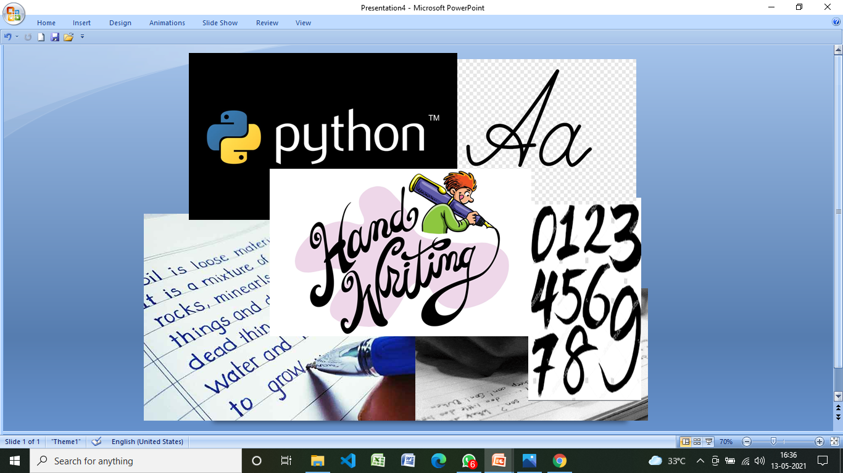
.
MINI PROJECT
DOMAIN:
MACHINE LEARNING
TITLE:
HAND WRITTING RECOGNITION
                by
                Poojasree SJ
                Vignesh C
                Ramani N

Slide 2
.
Project objectives:
The handwritten digits are not always of the same
size , thickness, or orientation and position relative to the margins.
It is a tough task for the machine because handwritten characters are not perfect. The same Characters differ in sizes, shapes and styles from person to person and even from time to time with the same person.
Handwritten Digit recognition is the solution to this problem that uses the image of a digit and recognizes the digit present in the image.

Slide 3
.
SVM
(Support Vector Machines)
In Machine Learning, Support Vector Machines (SVM) are supervised Learning models with associated learning algorithms that analyze data and recognize patterns, used for classification and regression analysis.
SVM is based on the concepts of decision planes that define decision boundaries.
A decision plane is one that separates between a set of objects having different class memberships.
SVM became famous when, using images as input, it gave accuracy comparable to neural-network with in a handwriting recognition task.
Currently, SVM is widely used in object detection & recognition, content-based image retrieval, text recognition, biometrics, speech recognition etc..
.

Slide 4
Divided into four steps :
Screen capture
Generate dataset and load it
Fit the model using SVC and calculate accurancy
Prediction of image drawn in paint

Slide 5
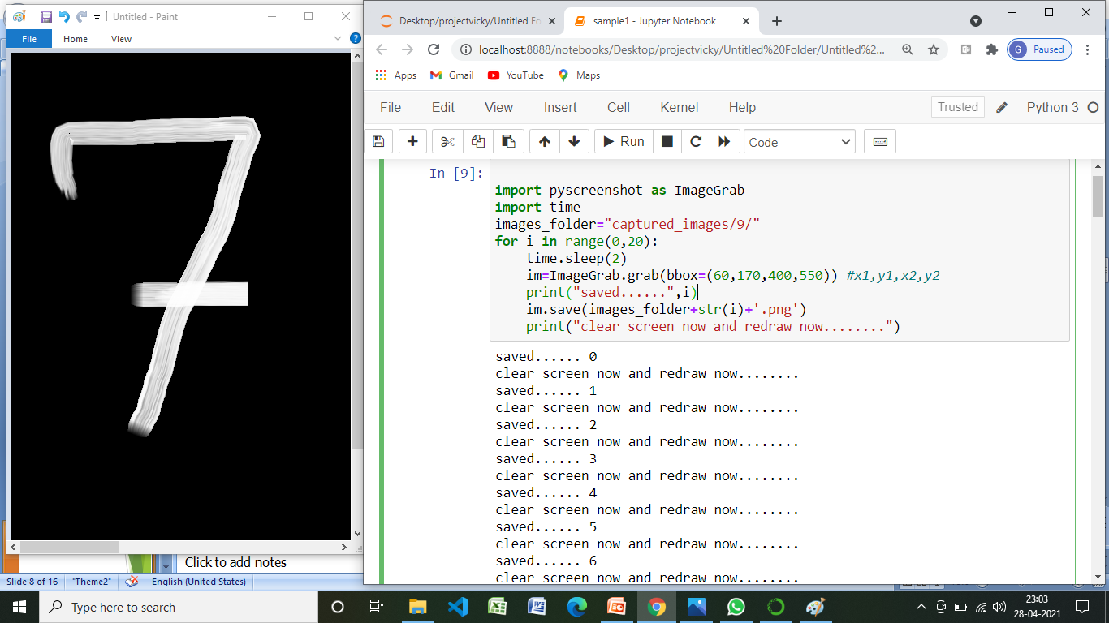
.
Screen capture
.
Using pyscreenshot we created own dataset
im=ImageGrab.grab(bbox=(60,170,400,550)) #x1,y1,x2,y2

Slide 6
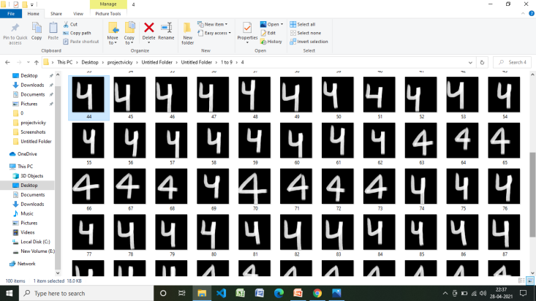
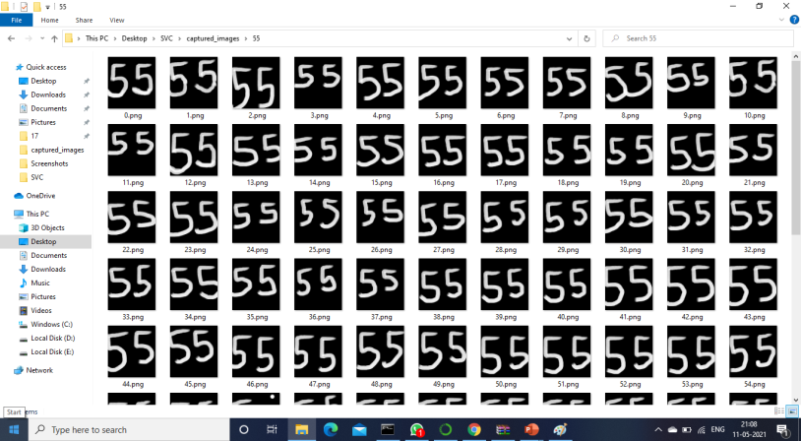
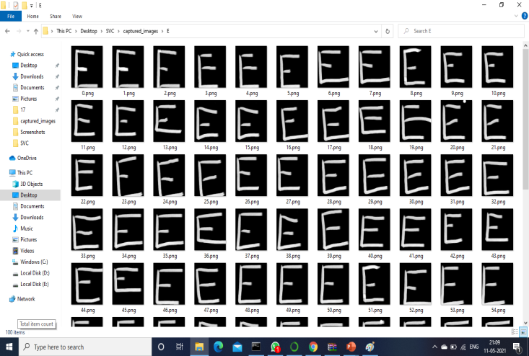
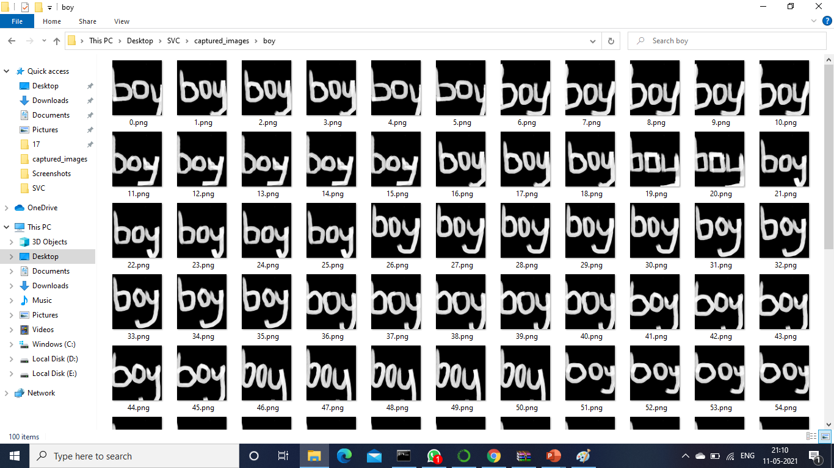
.
In our dataset , first we created 10 folders [0-9] for single digits, and then created 13 folders for double digits, 12 folders for Characters, 6 folders for words, in total we created 41 folders.
Each one has an 100 images and totally there are 4100 images.
For training we used 80% of dataset and for testing we used 20% of dataset

Slide 7
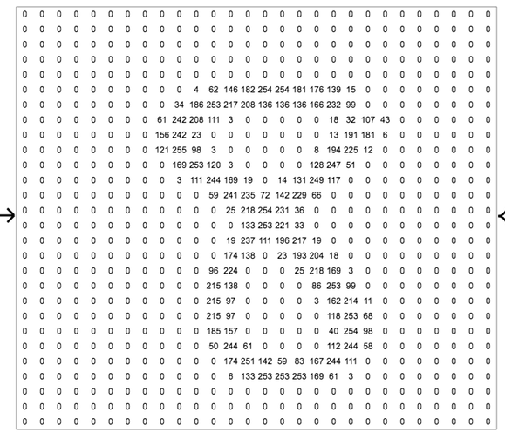
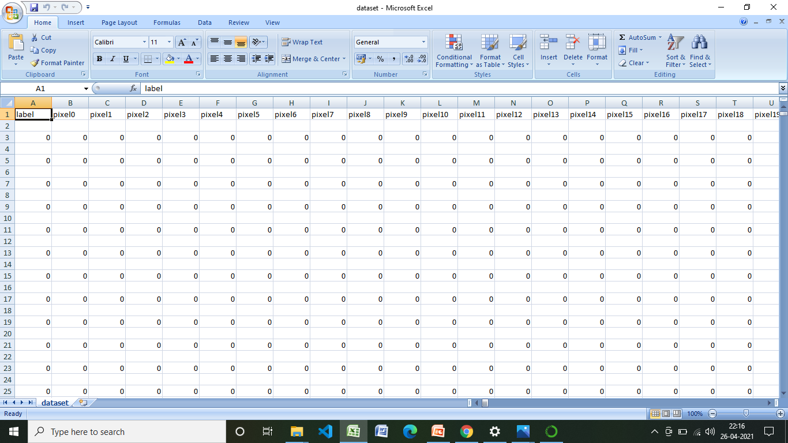
Generate dataset
Appended pixel value from 0 to 783
Extracted image folder
Read all the images using cv2 module
Convert rgb to grayscale image
Using gaussian blur method blur images
Resize the image into 28 *28 pixel
Add pixel one by one into data array
Append the data ie..0 & 1 value from pixel 0 to pixel 783

Slide 8
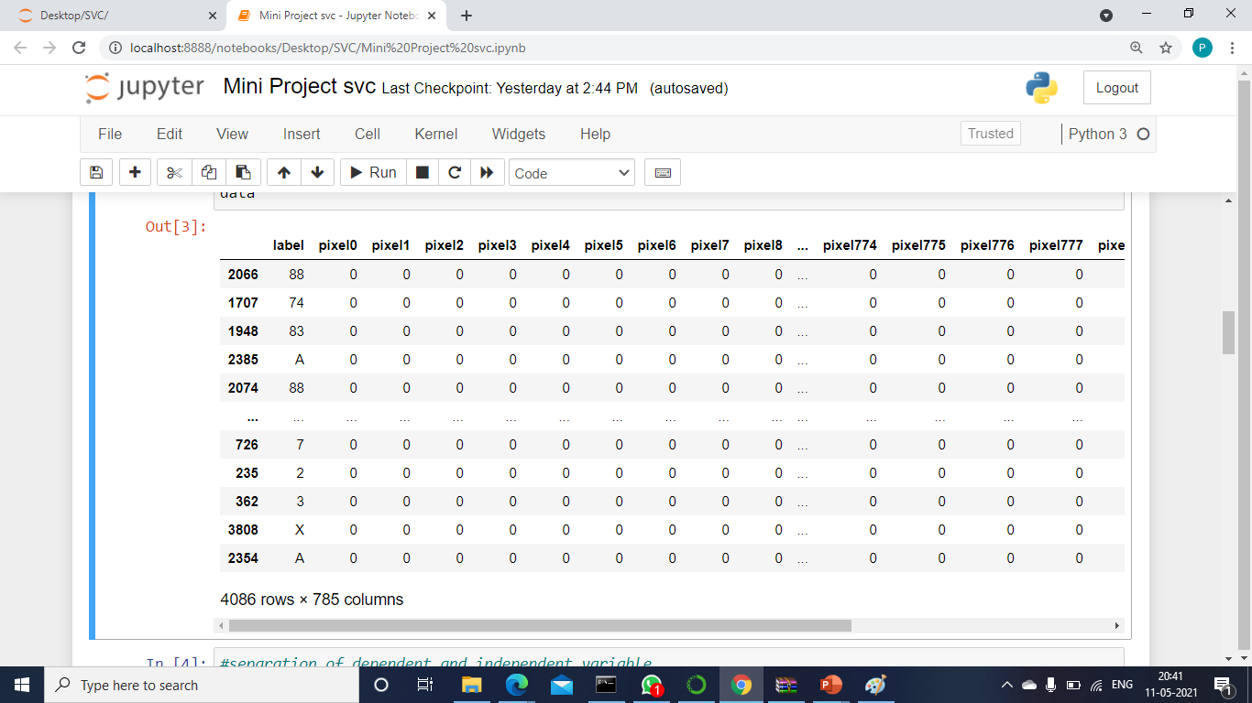
load the dataset
Loaded the data set using pandas library

Slide 9
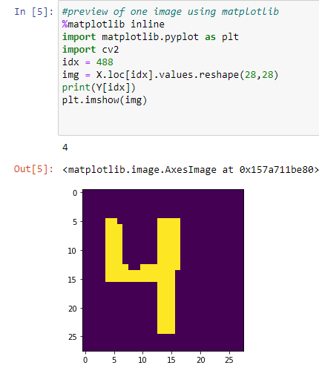
Separation of dependent and independent variable
Training dataset is stored in the form of x train & y train
Testing dataset is stored in the form of x Test & y Test
preview of image using matplotlib
Previewed
one image using index value from the loaded dataset

Slide 10
Train-Test split
80% of dataset for training the model
20 % of dataset for testing the model
Fit the model
Fit the model using svc & save the model using joblib

Slide 11
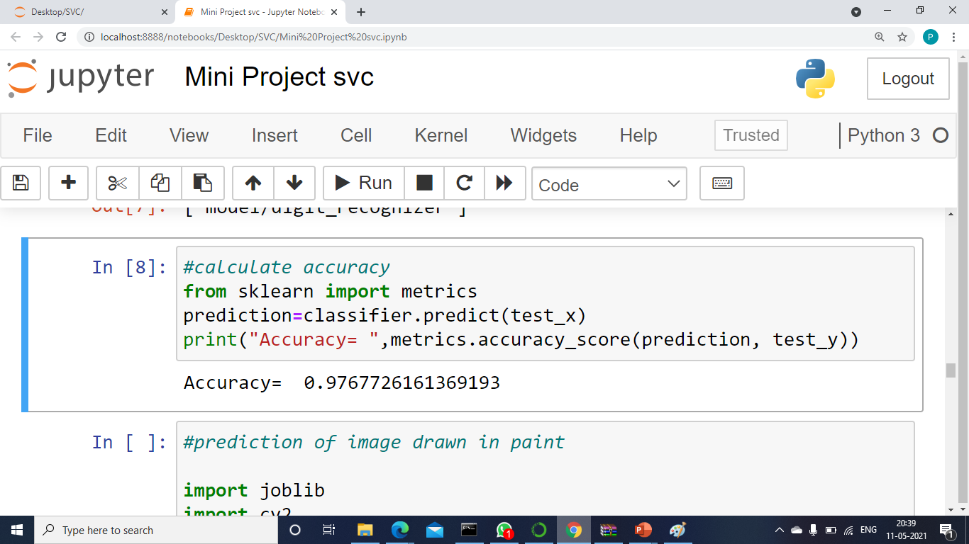
calculate accuracy
Testing dataset x test & y test is used to predict the image & calculate its accuracy

Slide 12
Prediction of image drawn in paint
predicting image using paint & pyscreenshot
And then using time module it will predict after completion of that time
Threshold the image
And then finally it will predict succesfully
Add pixel one by one into data array
.

Slide 13
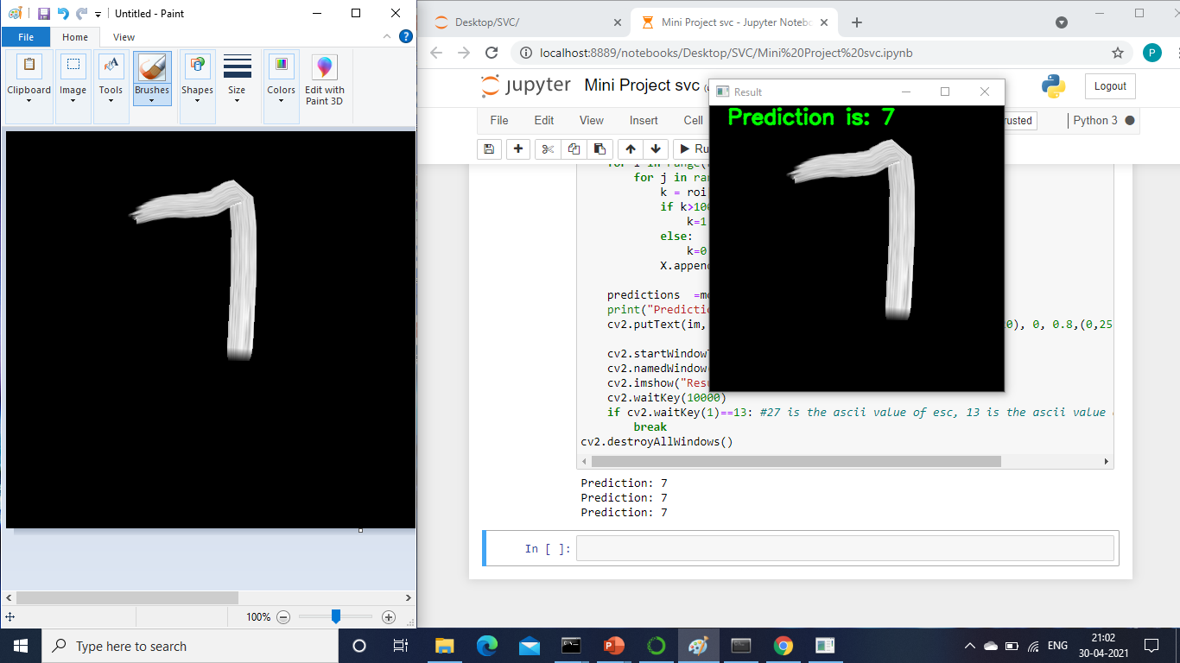
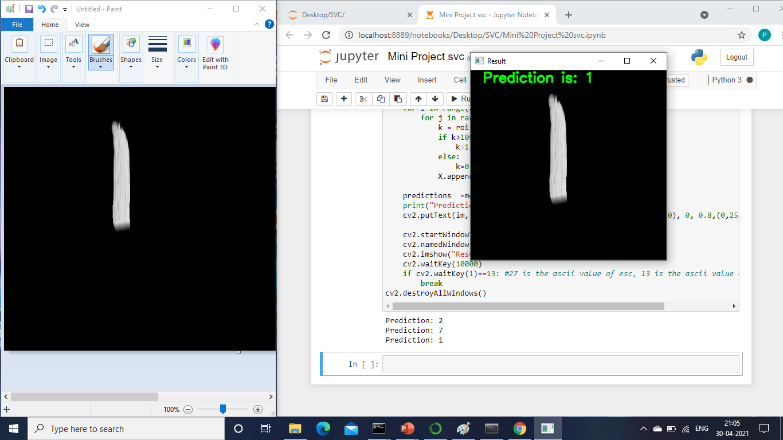
RESULTS AND OUTPUTS :
FOR SINGLE DIGITS

Slide 14
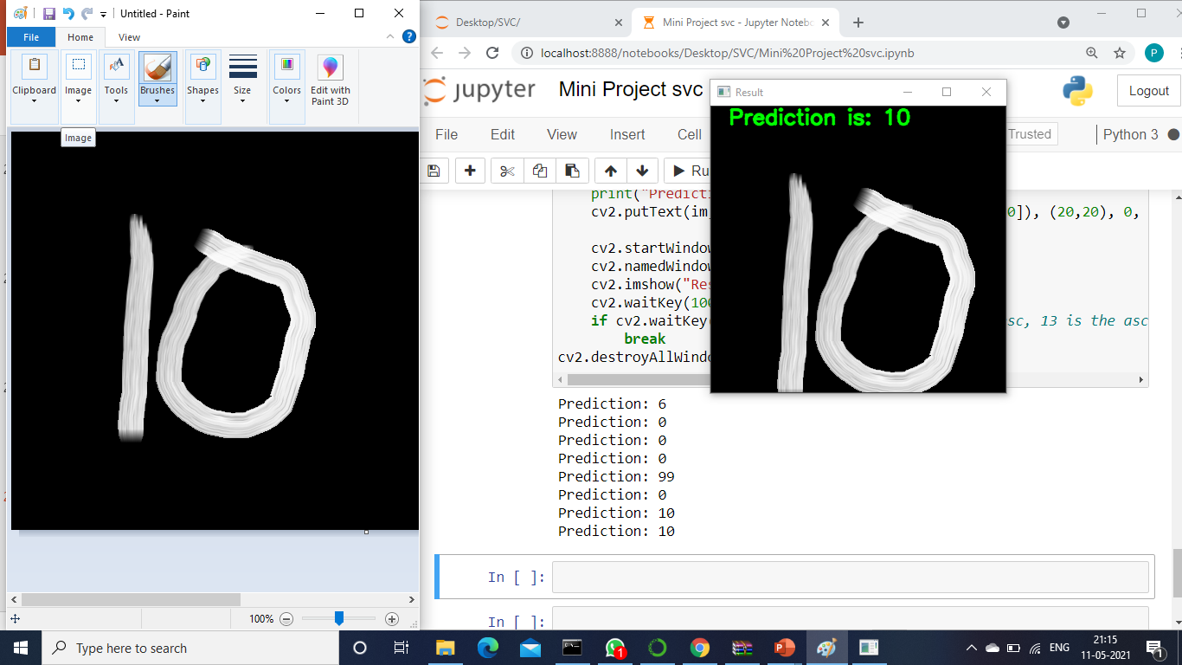
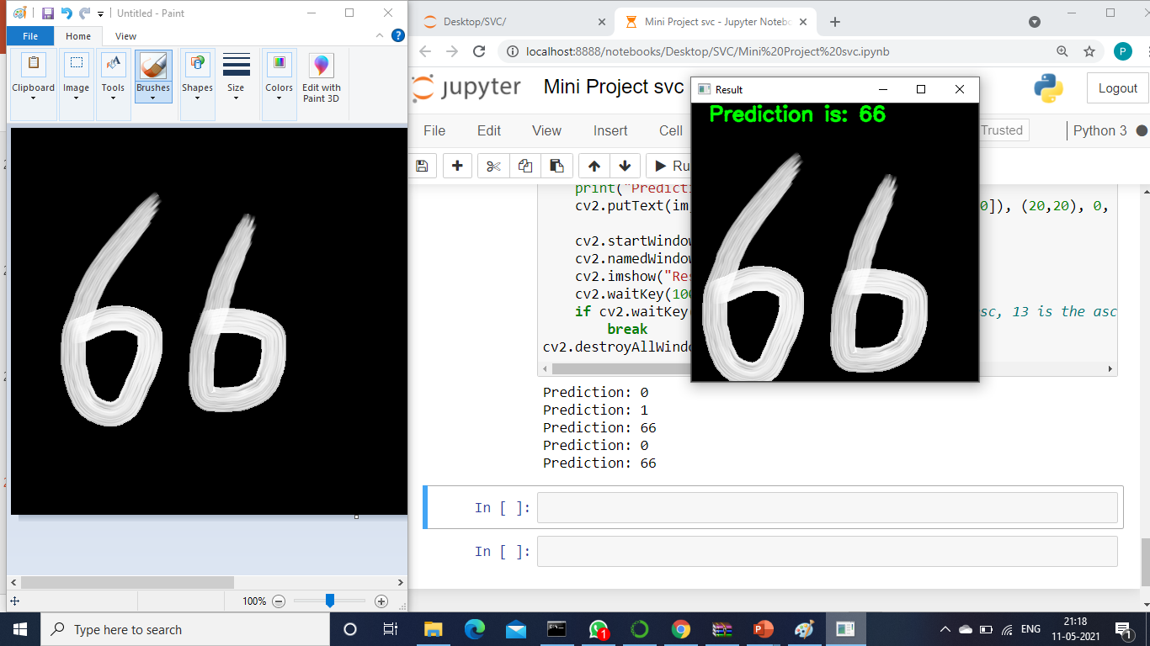
FOR DOUBLE DIGITS :

Slide 15
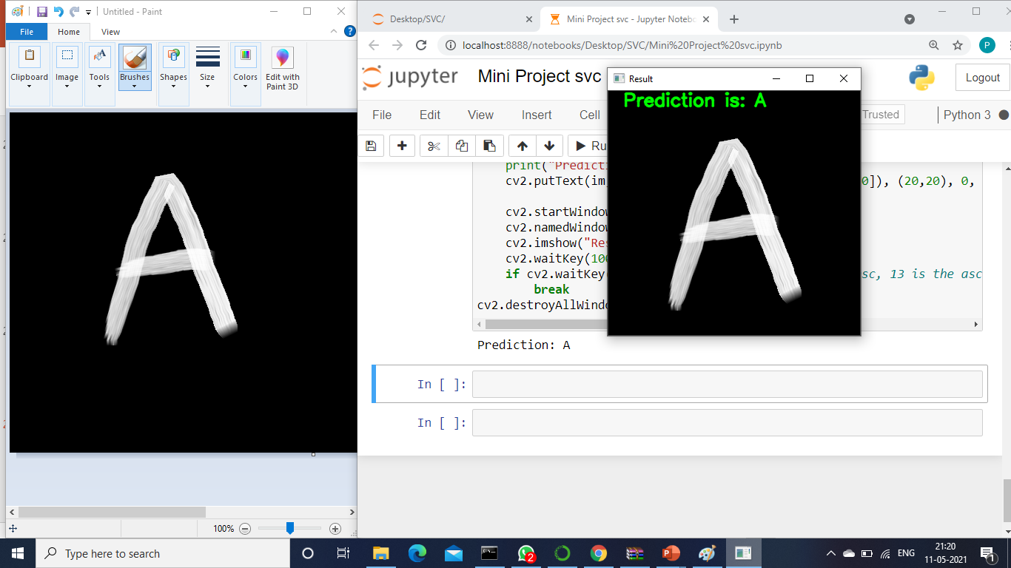
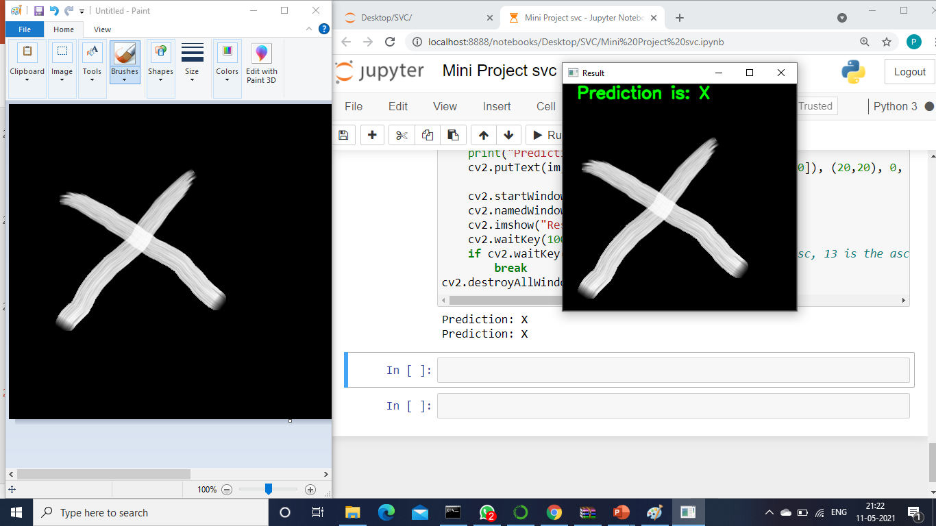
FOR CHARACTERS :
.

Slide 16
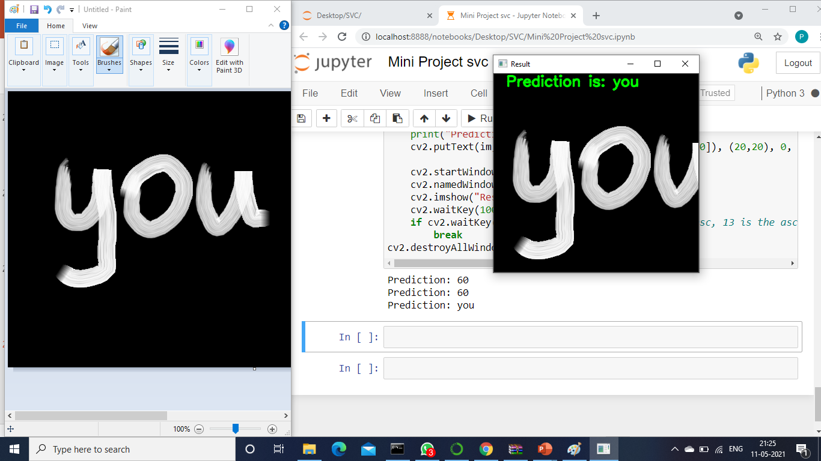
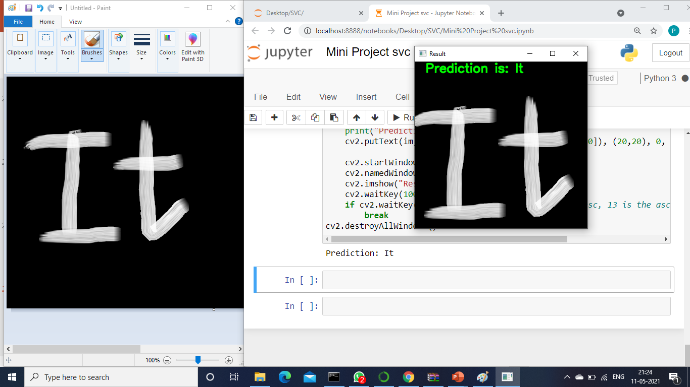
FOR WORDS :

